Slide 2
Deep Dive: cncf.ci v3
W. Watson & Denver Williams,
Vulk Cooperative
Notes:
updated by LS 10-30-2019
Deep Dive: cncf.ci - W. Watson and Denver Williams
Wed, 11/20 | 10:55 - 11:30am
https://sched.co/UahV

Slide 3
Agenda:
Quick Intro
cncf.ci Team, Goals, Key features
Dashboard Walk-through
Deep Dive: Adding new CNCF-projects
How to
Challenges
Benefits
Code Review
Stay Connected
Q&A [5-10 minutes]
Notes:
Quick Intro [10-12 minutes]
CNCF CI Team, Goals, Key features
Dashboard Walk-through
Deep Dive: Adding Arm Support
Challenges
Benefits
Code Review
Get Involved
Q&A [10-15 minutes]

Slide 4
Meet Vulk Cooperative
Content
Worker-owned software cooperative
Since 2013
Meetups in Austin, TX
Austin Software Co-operatives
Open Source Axes
Connect with us
twitter.com/vulkcoop
twitter.com/opensourceaxes
vulk.coop
Notes:
Worker-owned software cooperative
Celebrating 6 years in operation
4 worker-owners, 5-10 associates
Geographically distributed team
Meetups in Austin, TX
Austin Software Co-operatives
Open Source Axes
twitter.com/vulkcoop
twitter.com/opensourceaxes

Slide 5
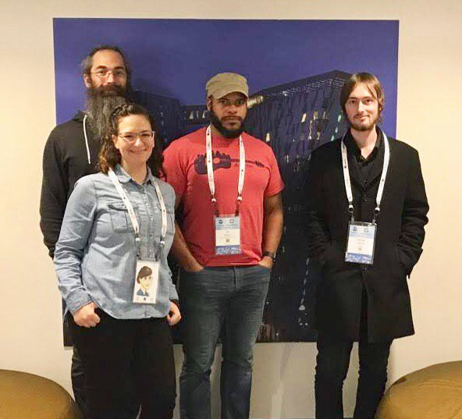
Meet the cncf.ci Team
Taylor Carpenter
@taylor
Lucina Stricko
@lixuna
W. Watson
@wavell
Denver Williams
@denverwilliams
Ashleigh Gregory*
@ashleighgregory
William Harris*
@williscool
Joshua Smith*
@nupejosh
Robert Siekmann*
@rsiekmann
Notes:
Here is part of the cncf.ci team at KubeCon EU 2018 in Denmark
Taylor, Watson, Denver and myself
*not pictured team members Ashleigh, Will, Josh and Robert

Slide 6
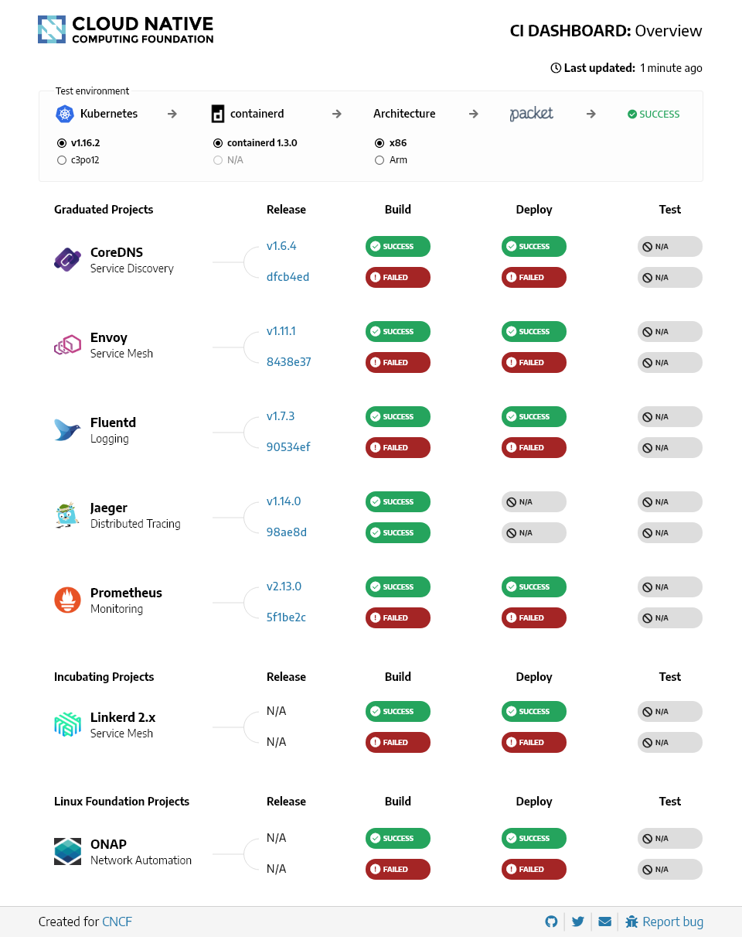
Intro
cncf.ci
Notes:
The cncf.ci project consists of a CI testing system, status repository server and a dashboard -- cncf.ci.

Slide 7
Intro
The cncf.ci project consists of a CI testing system, status repository server and a dashboard -- cncf.ci.
The CI testing system validates the build and deployment of each CNCF project for any commit on stable and HEAD using x86 and Arm architectures on bare metal (Packet) servers.
The CI testing system can reuse existing artifacts from a project’s CI system or generate new build artifacts.
The status repository server collects the test results and the dashboard displays them.
Notes:
The cncf.ci project consists of a CI testing system, status repository server and a dashboard -- cncf.ci.

Slide 8
Goals
Goals:
To compliment the CNCF landscape and trail map -- l.cncf.io
To promote CNCF hosted projects and help attract more projects to CNCF
To demonstrate the use of cloud native technologies on multiple test environments
To support and contribute to a sustainable and scalable project ecosystem
To get feedback from cloud native end users and projects
To provide a third party, unbiased validation of build, deploy and e2e tests for CNCF Graduated and Incubating projects
Notes:
Landscape.cncf.io

Slide 9


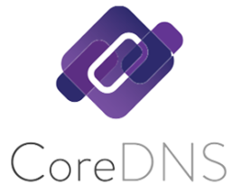








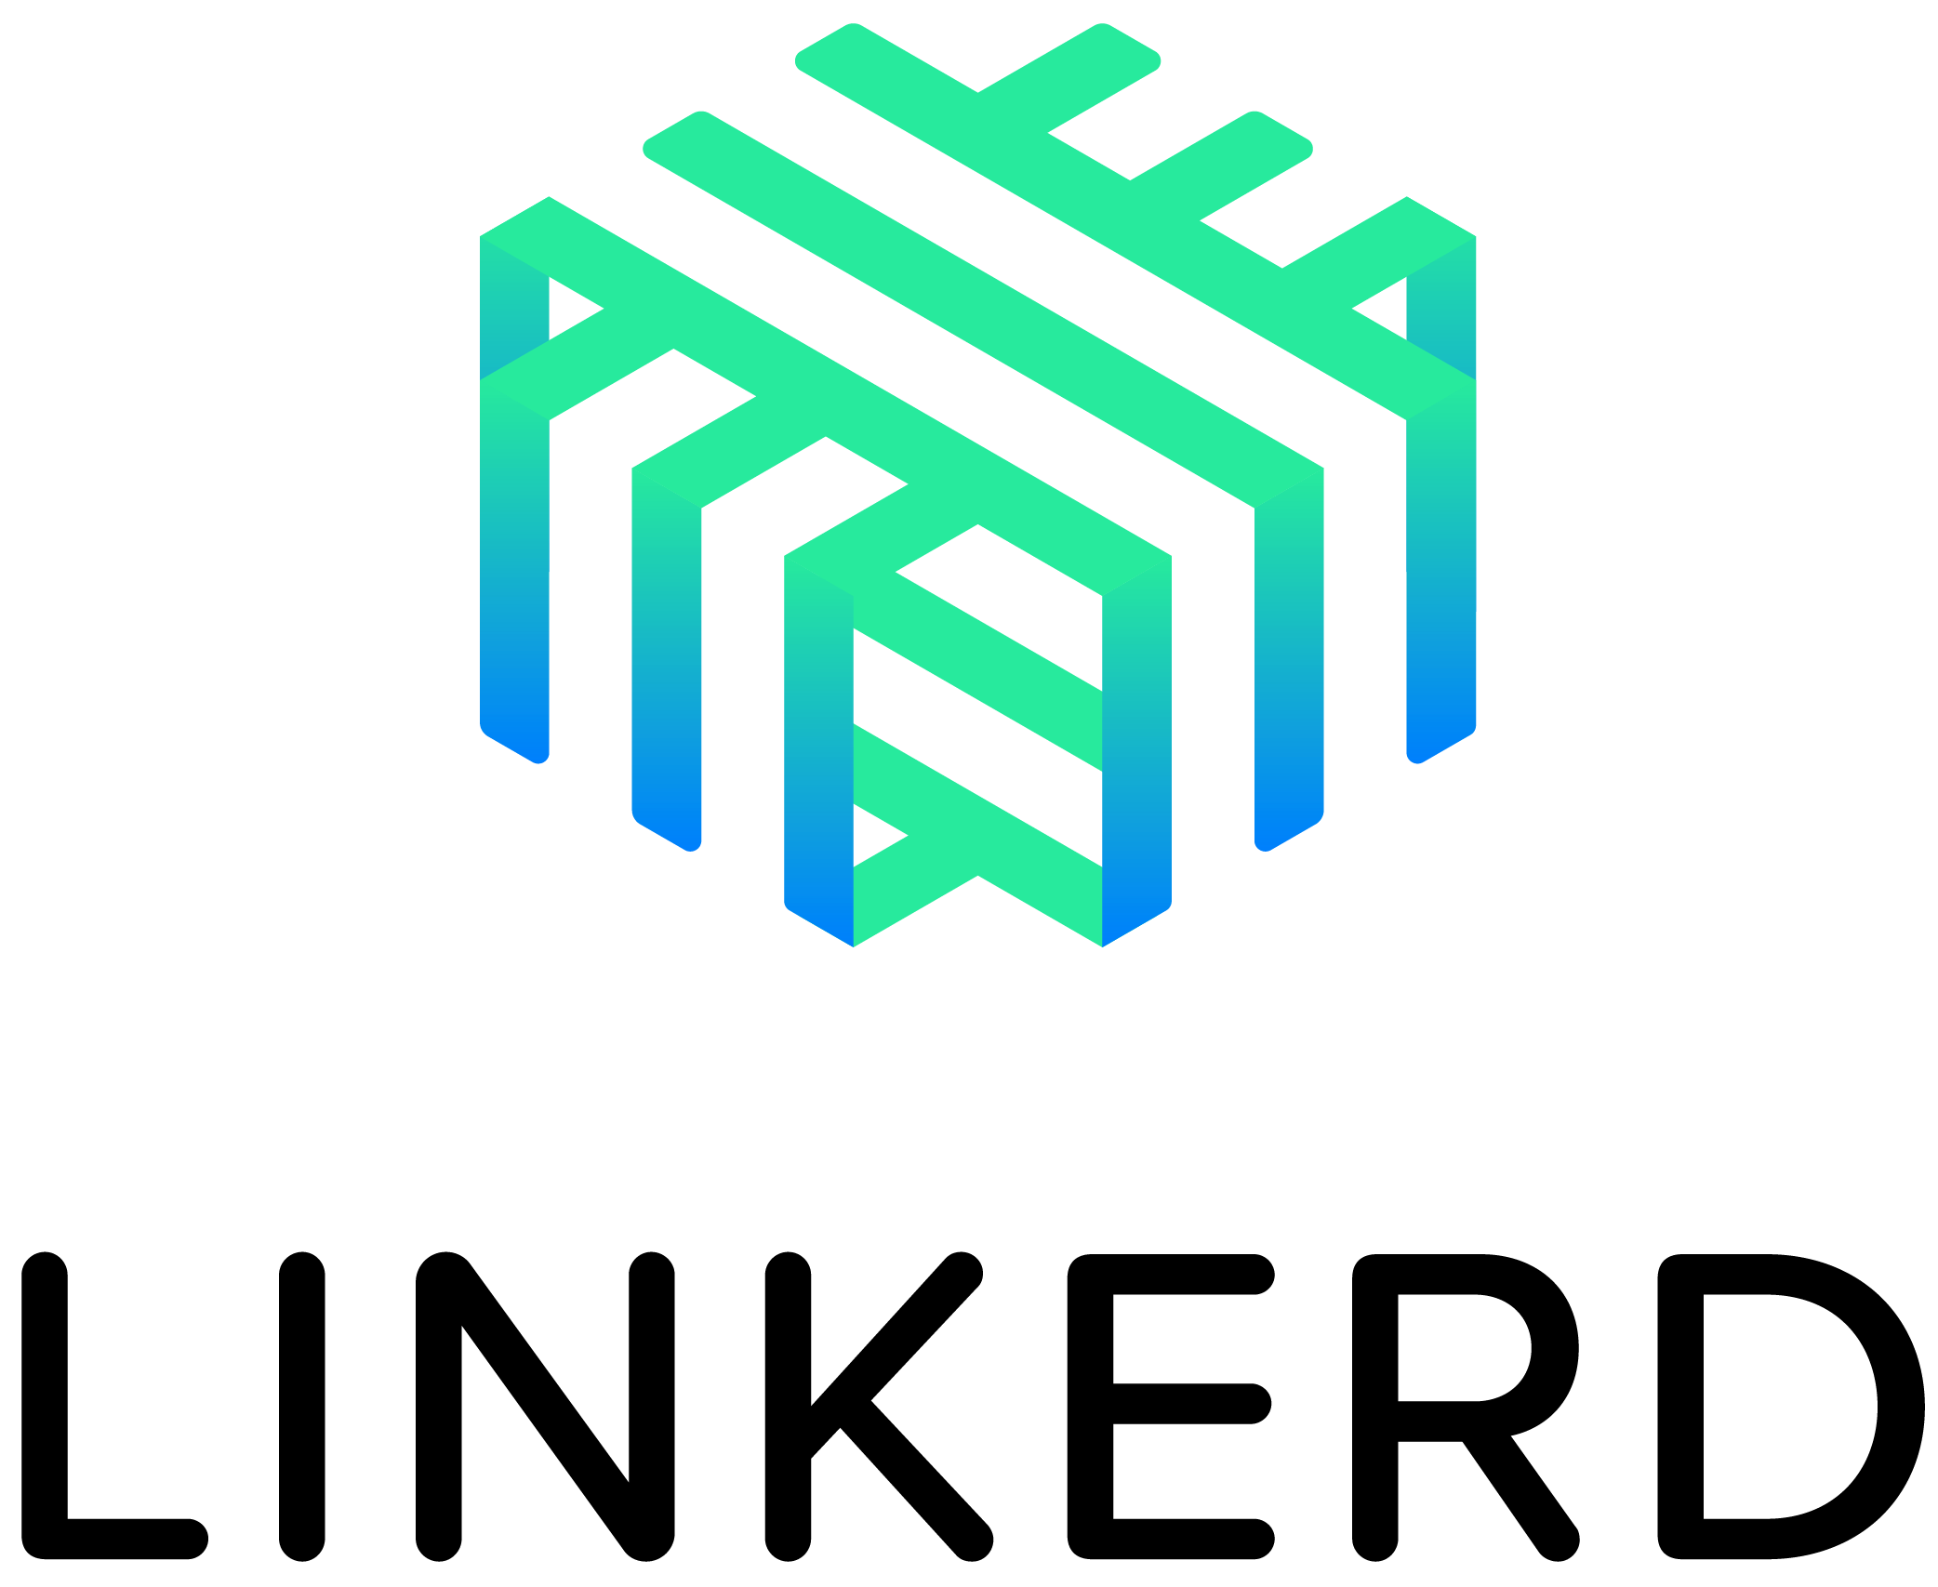


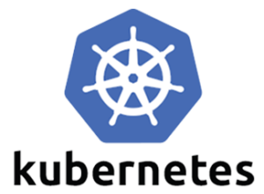









Displaying CNCF Projects
Notes:
8 Graduated
15 Incubating
20 Sandbox

Slide 10

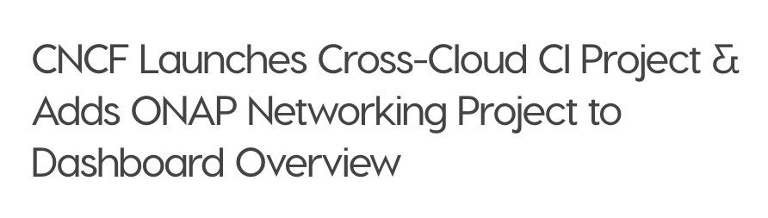
Displaying ONAP SO Project
“...Our CNCF demo at ONS will illustrate to carriers that Kubernetes and ONAP are key to the future of network virtualization.”
Dan Kohn, CNCF executive director

Slide 11
Key features of cncf.ci

Slide 12
Key Features
1. Project-centric -- highlight and validate CNCF-hosted Graduated and Incubating projects:
Validate stable and HEAD releases of Graduated and Incubating projects
Re-use build containers that are provided by a project’s CI System
Re-use upstream Helm charts
Re-use end-to-end tests provided by projects

Slide 13
Key Features
2. Collaboration -- increased engagement with CNCF Project maintainers:
Maintainers can update project and release details via a GitHub pull request
Maintainers can provide Helm charts and smoke tests for the deploy phase
Maintainers can provide end-to-end tests for the test phase
CI Testing System will integrate with external CI systems to retrieve a CNCF Project’s build status and container artifacts

Slide 14
Key Features
3. Agnostic testing -- validate projects in a configurable and neutral test environment:
Per Kubernetes Release
Stable
HEAD
Per Architecture
X86
Arm
Bare Metal
Packet

Slide 15
Dashboard
Walk-through
Notes:
Walk-through cncf.ci dashboard

Slide 16
Walk-through: cncf.ci
cncf.ci
Notes:
Cncf.ci refreshes daily at 3AM Eastern Time

Slide 17
Walk-through: cncf.ci
cncf.ci
Notes:
Feature: Test environment
Provisions test environments for K8s release and architecture types on Packet servers using CNCF-Graduated project, containerd as the runtime

Slide 18
Deep Dive
How to add a CNCF-project to cncf.ci
Notes:
With that in mind, I will hand it over to Denver Williams for an in-depth look of how we added new projects with Travis CI integration. I’ll see you later for Q&A.
Thanks, Watson. Hi I’m Denver. I’ll share challenges, benefits, code review, how to get involved, Q&A.

Slide 19
How to Add a Project
Notes:
Denver Williams

Slide 20
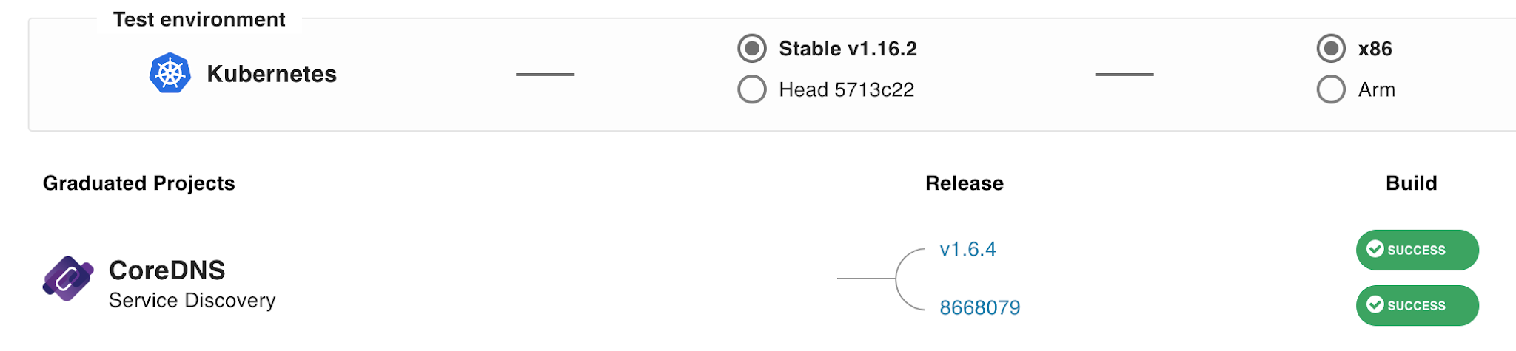
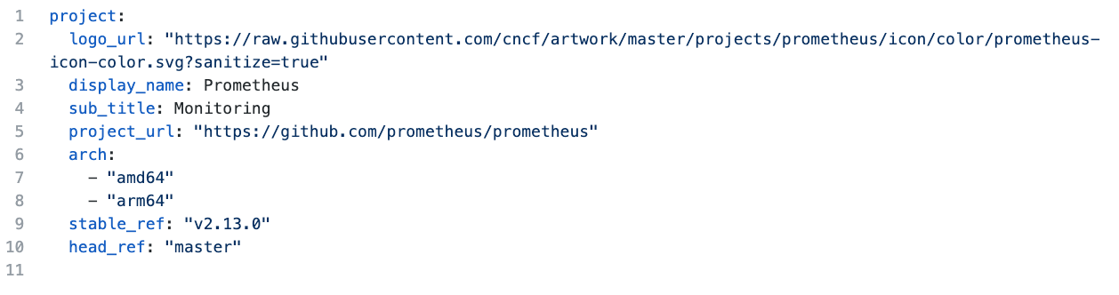
Project Maintenance
Go to https://github.com/crosscloudci
Open the <project>-configuration repo for your CNCF Project, ie. prometheus-configuration
Create a fork of the project to make updates
Open the cncfci.yml file on the master branch
Update content, as needed:
logo_url: "https://raw.githubusercontent.com/cncf/artwork/master/prometheus/icon/color/prometheus-icon-color.svg?sanitize=true" (for svg format, append ?sanitize=true to url)
display_name: (e.g. Prometheus)
sub_title: (e.g. Monitoring)
stable_ref: (e.g. v2.13.0)
head_ref: (e.g. master)
project_url: (e.g.. "https://github.com/prometheus/prometheus")
Submit a pull request to master branch

Slide 21
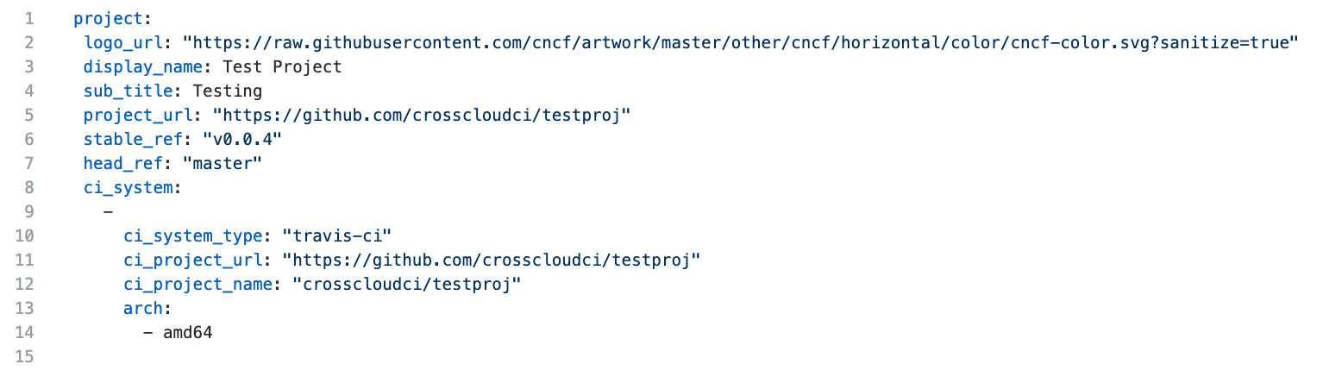
CI System Configuration
Create a ci_system element
The ci_system element is an array which represents a list of all of the ci_systems (e.g. multiple Travis endpoints, a Travis and a Jenkins endpoint, etc) for a project
ci_system_type is the type of ci system. Use "travis-ci" for Travis
ci_project_url is the source control url for the project.
ci_project_name is the organization and project name of the project in the ci_system (e.g. crosscloudci/testproj)
arch is a list of architectures that are supported. e.g. amd64, arm64

Slide 22
Challenges

Slide 23


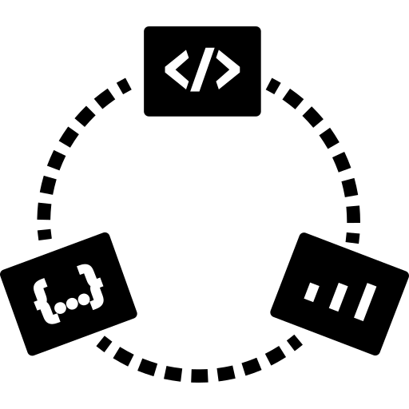

Cross Pipeline Problem
One organization
A pipeline
A ci/cd tool
Is used by …
Another organization
A different pipeline
Which uses different CI/CD tool

Slide 24
Benefits

Slide 25
Clear Engagement Steps
Allows project maintainers to have more control over the visibility of their project
Branding
Logos
Names
Subtitles
Release
Stable version
HEAD branch

Slide 26
Cross-Pipeline Architecture
Standard way to consume
Build status
Artifacts
Test status
Abstract away changes that occur in versions of the CI/CD tool

Slide 27
Code Review

Slide 28
Retrieve Build Status
Review .gitlab-ci.yml and make a note of the curl command that calls the external ci proxy (i.e. https://github.com/crosscloudci/<your-project>-configuration/blob/master/.gitlab-ci.yml)
Artifacts and test statuses will be retrieved in a similar manner in the future

Slide 29
Optional: Build a CI Proxy Plugin
https://github.com/crosscloudci/ex_ci_proxy/blob/master/README.md
What is a ci proxy plugin?
A Simple CLI tool for consuming status information from a project’s CI/CD pipeline
CI CLI API
Arguments
-p or --project is the project name in the format of orgname/project
-c or --commit is the commit reference
-t or --tag is the tag name
Status executable and response format
The output is tab delimited
The first line is a header
The second line is data
The status should be success, failure, or running
The build_url should be the url where the status was found

Slide 30
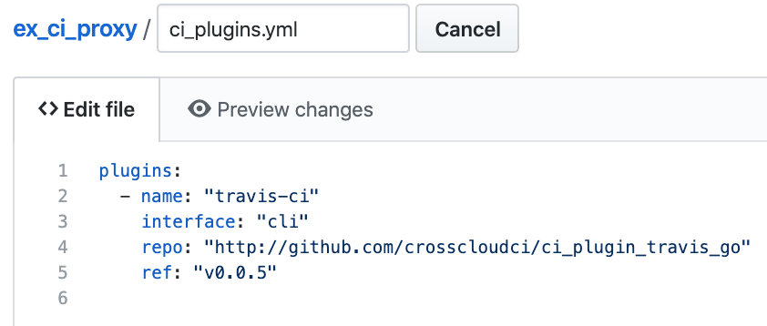
Optional: Build a Proxy Plugin
Why have a CI Proxy?
One stop shop for statuses
Build status
Artifact links
Integration test results
Add CI Proxy plugin configuration
Name is the name of the plugin
Interface type of plugin
Repo is the github location of the plugin
Ref is the branch or tag of the plugin

Slide 31
Get Connected

Slide 32
How to Collaborate
Add/update a CNCF project, see the Contributing Guide:
https://github.com/crosscloudci/crosscloudci/blob/master/CONTRIBUTING.md
Create issues/PR on GitHub:
https://github.com/crosscloudci/ci-dashboard/issues
Subscribe to the CNCF CI public mailing list:
https://lists.cncf.io/g/cncf-ci-public
Join #cncf-ci on CNCF Slack:
https://slack.cncf.io
Attend CI WG Public Meetings:
https://github.com/cncf/wg-ci
4th Tuesday of month > Next Meeting: January 28th
Notes:
The cncf.ci dashboard is ready to add Graduated and Incubating projects. Please see the contributing guide to get started. Create Pull Requests or issue on GitHub, subscribe to the mailing list, join slack, or attend the CI Working Group calls

Slide 33





Connect with the Team
@crosscloudci
@cncfci / @vulkcoop
#cncf-ci
cncfci@vulk.coop
Notes:
Stay connected on GitHub, Twitter, slack and email
I think we have time for some questions

Slide 34
Q&A

Slide 35
Thank You!
Presentation prepared by:
w.watson@vulk.coop
denver@debian.nz
lucina@vulk.coop
ashleigh@vulk.coop
taylor@vulk.coop

Slide 36
Notes:
Intro: CNCF CI - Wavell Watson & Denver Williams, Vulk Coop & CNCF
https://sched.co/UahV
Wednesday, November 20 • 10:55am - 11:30am
Room 6D

